Slide 1

TRIPIFY: Ticket Booking & Management System
Presented By
Abhijeet Take & Abhyuday Ghatale

Slide 2
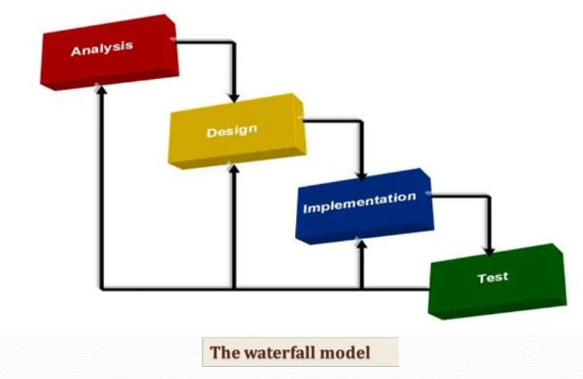
Introduction
The “TRIPIFY” is Ticket booking as well as management online system.
We used waterfall model during project life cycle

Slide 3
Technology Used
We used:-
.NET FRAMEWORK as backend
MySQL as database
React JS as Frontend in our Project.

Slide 4
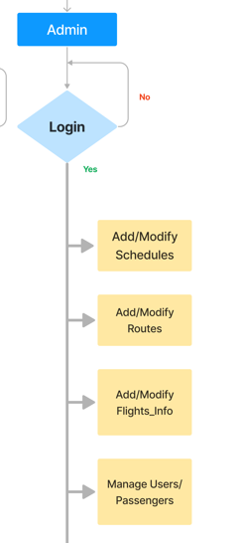

Use Case diagram for ADMIN

Slide 5
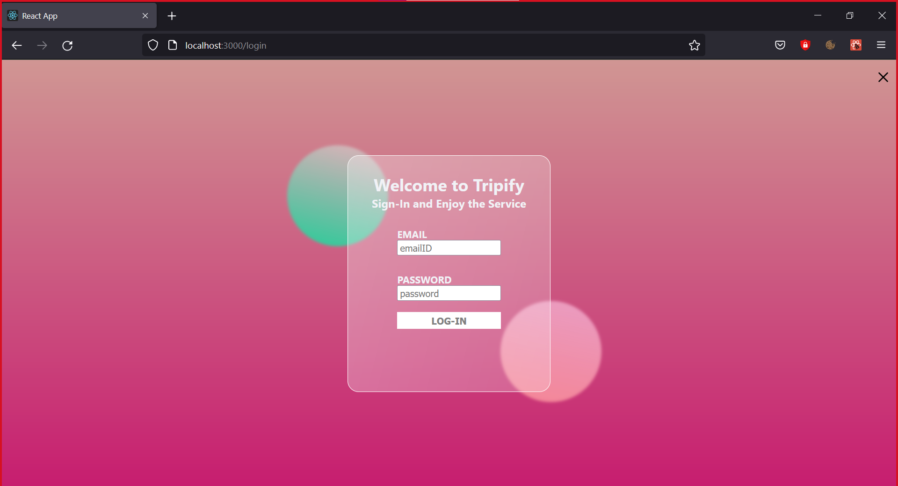

Slide 6
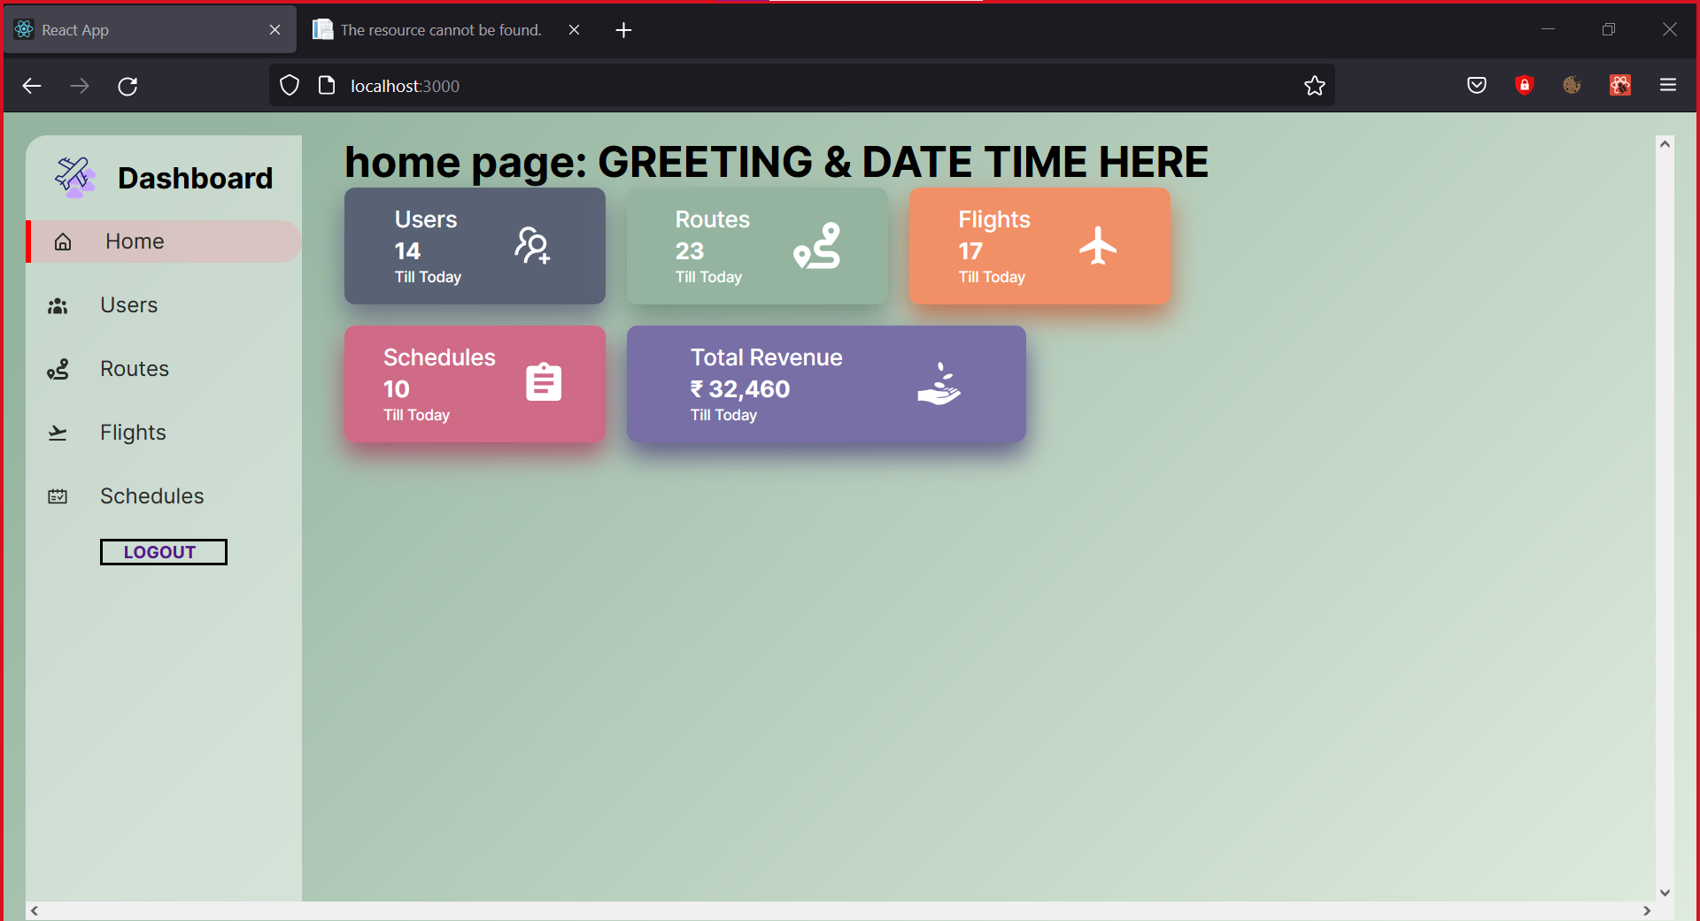
Home page

Slide 7
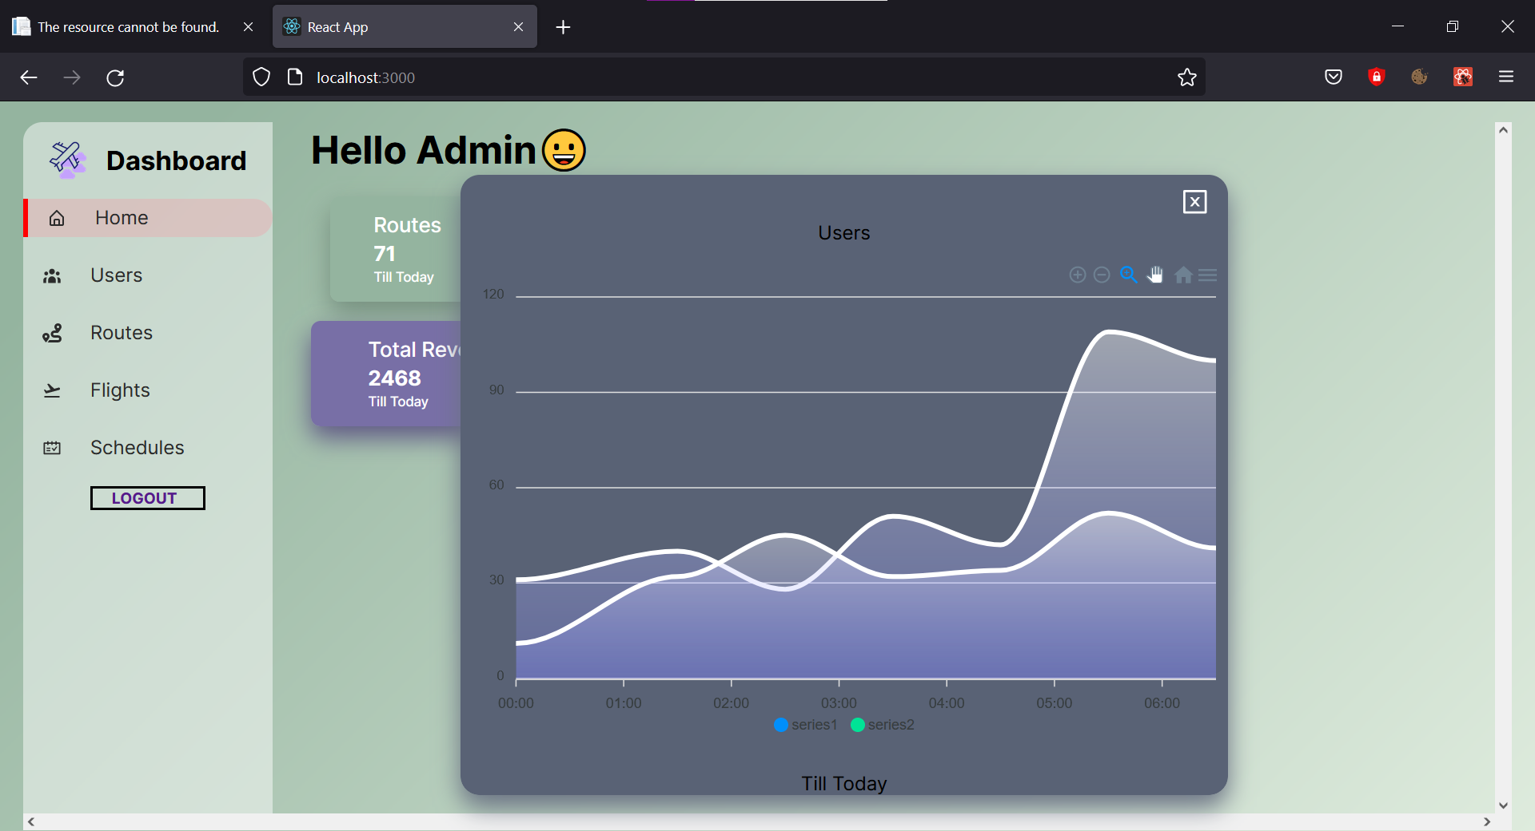
Statistical analysis of each card

Slide 8
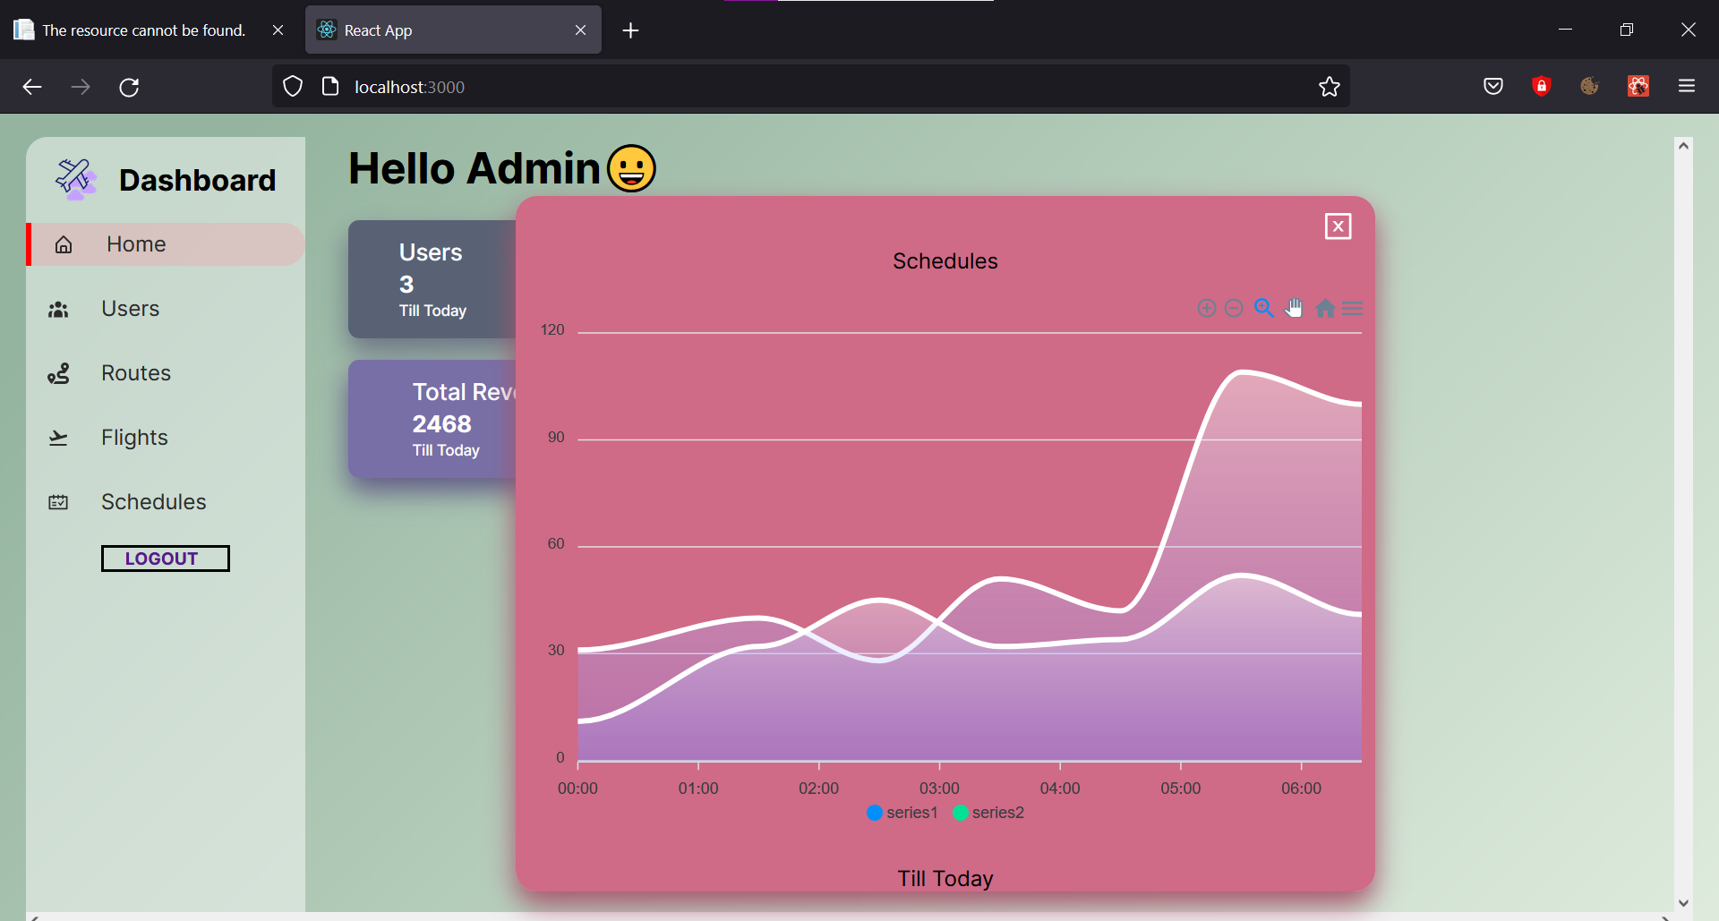
Statistical analysis of each card

Slide 9
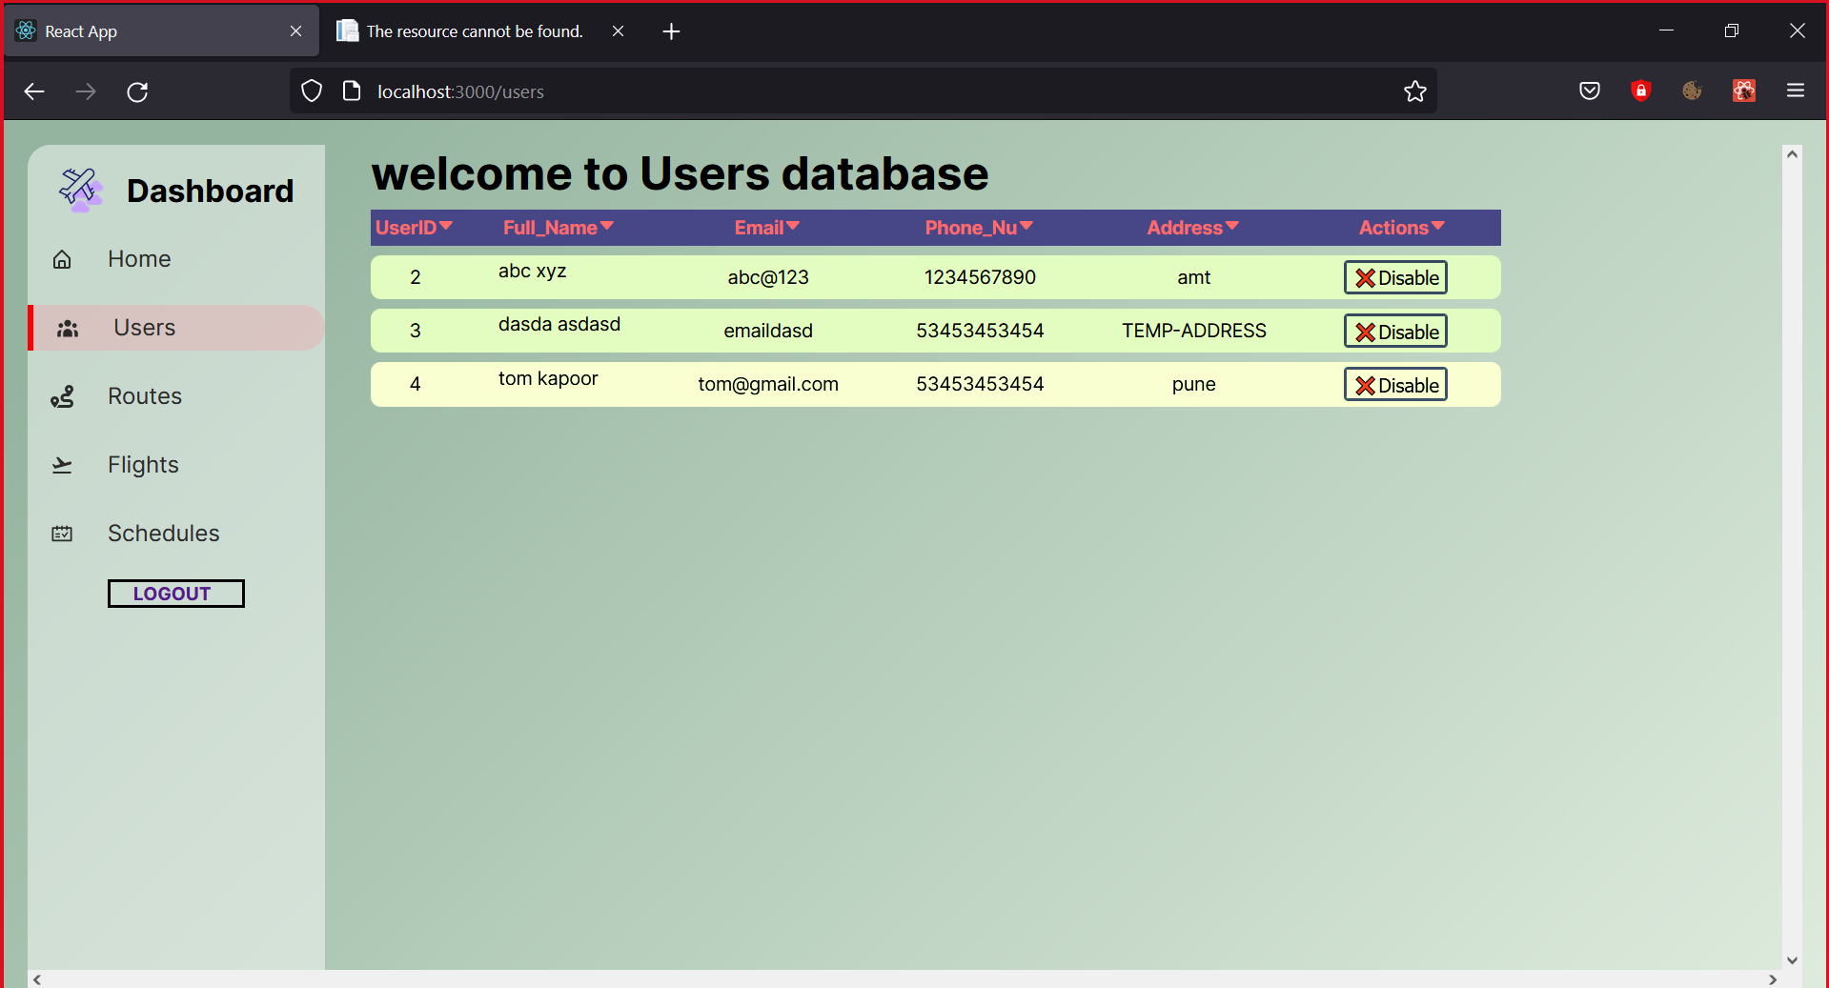
USERs info & option to terminate their session

Slide 10
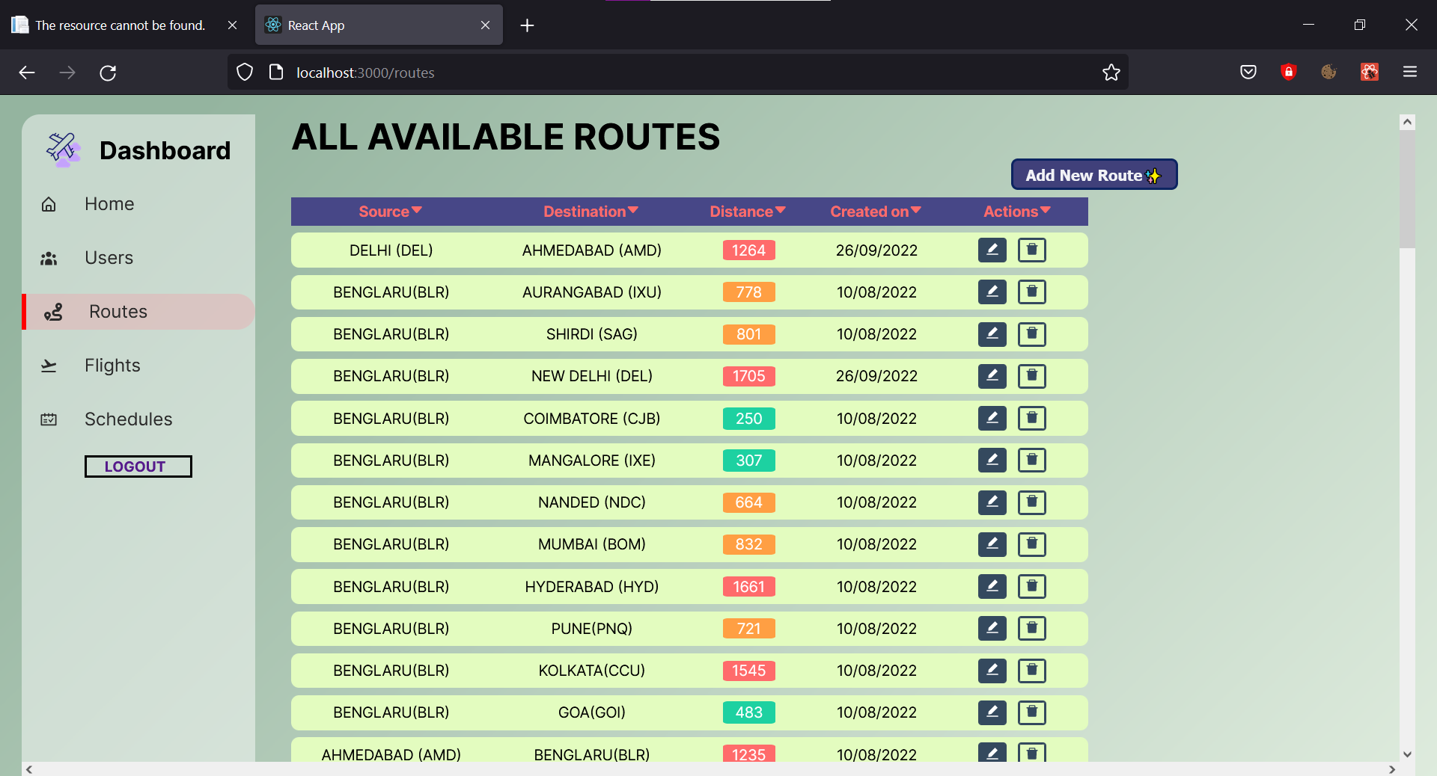
ALL ROUTES DATA

Slide 11
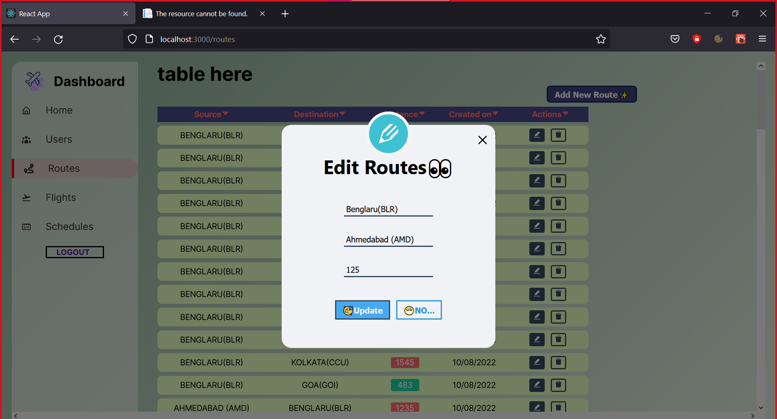
EDIT ROUTES

Slide 12
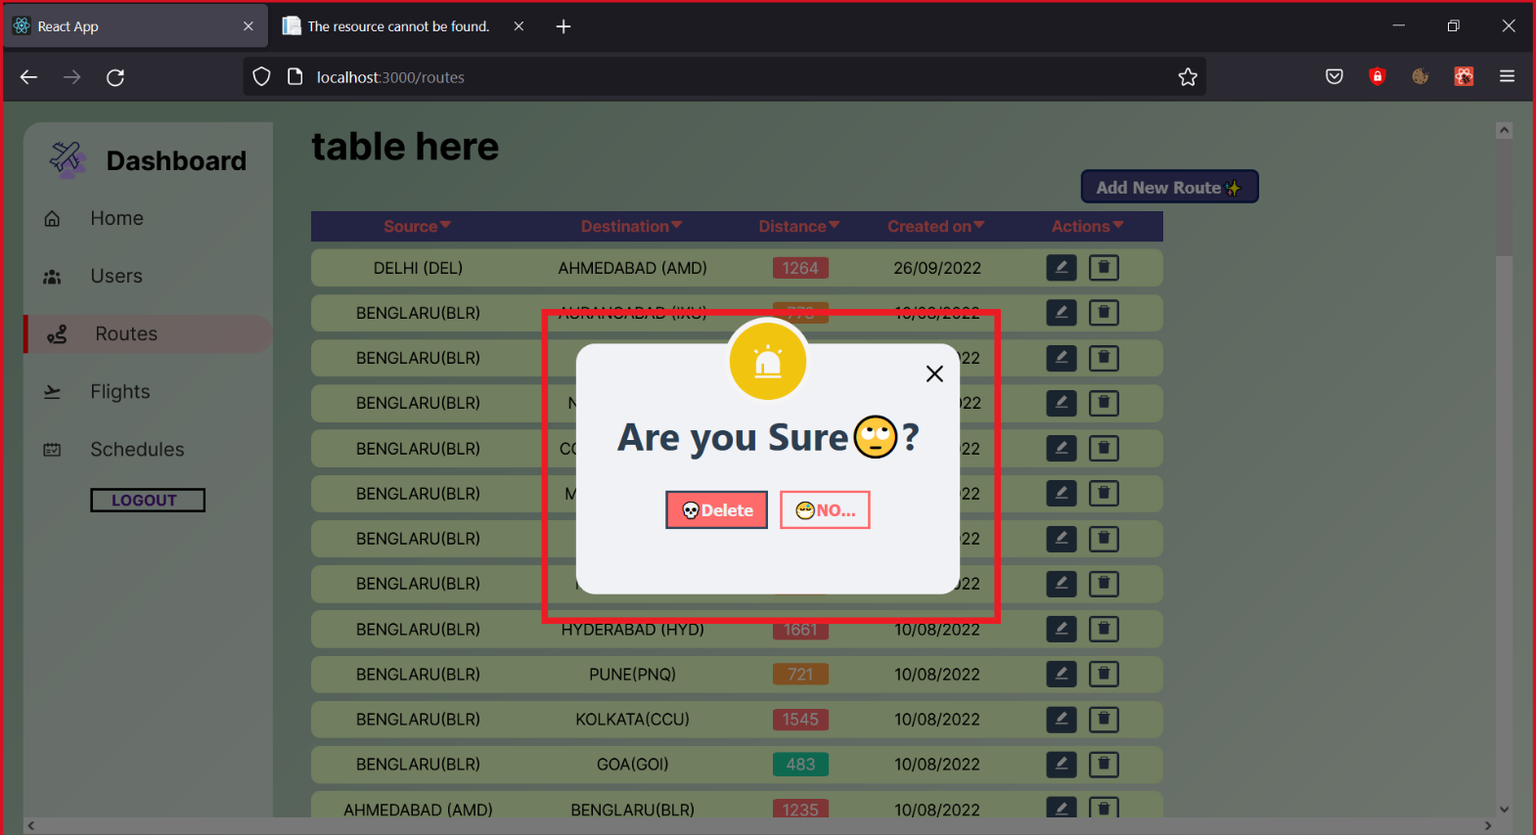
DELETE ROUTES

Slide 13
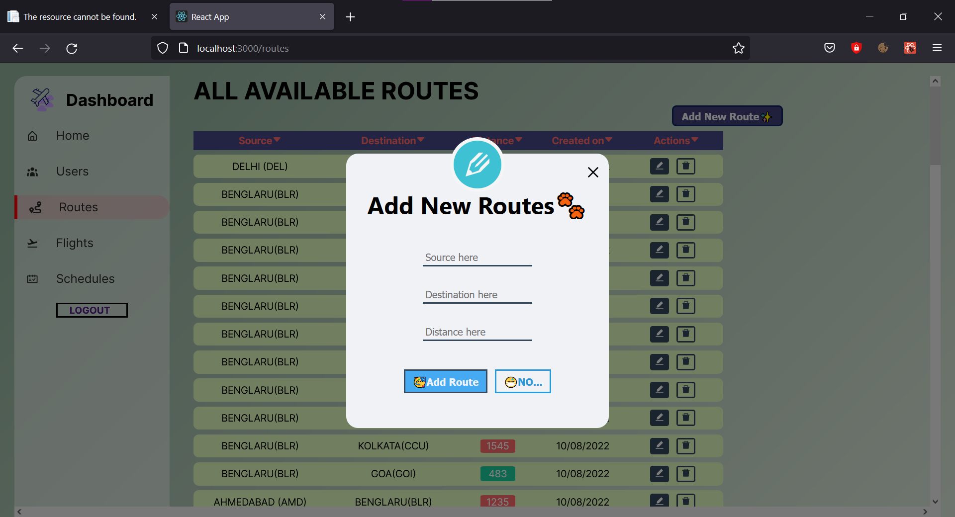
ADD NEW ROUTES

Slide 14
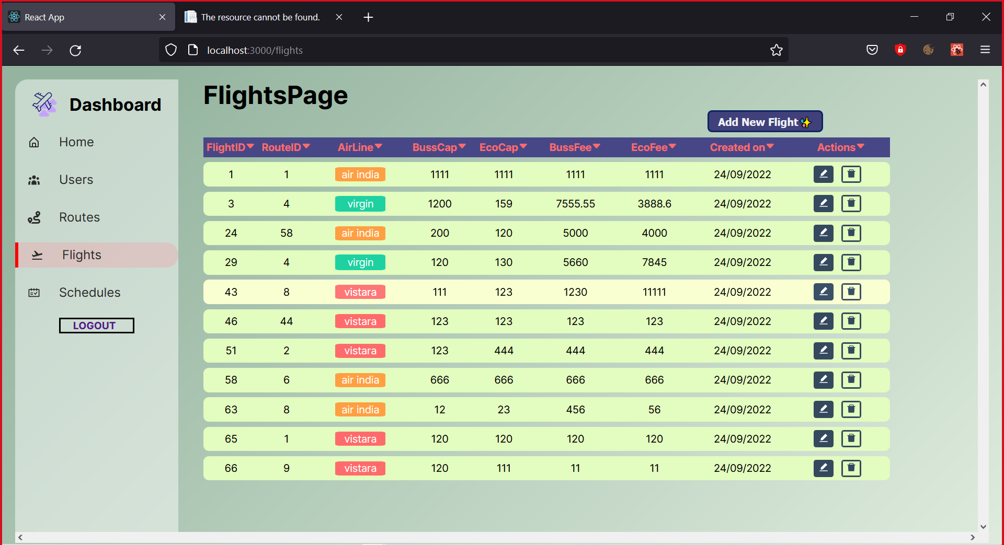
ALL FLIGHTS DETAILS

Slide 15
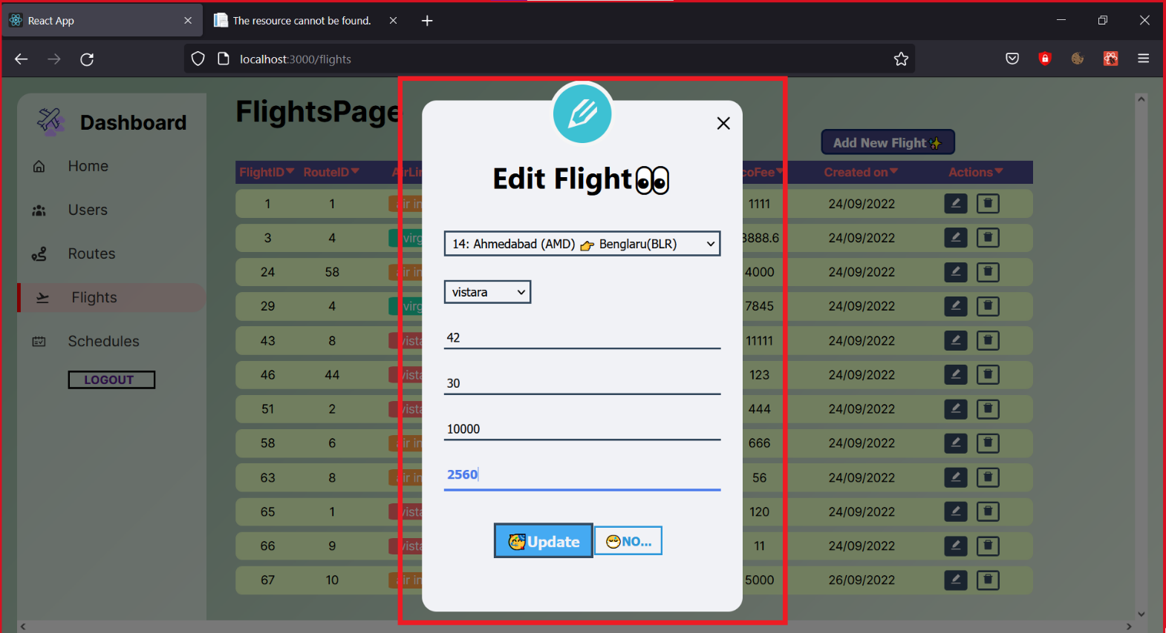
EDIT FLIGHTS

Slide 16
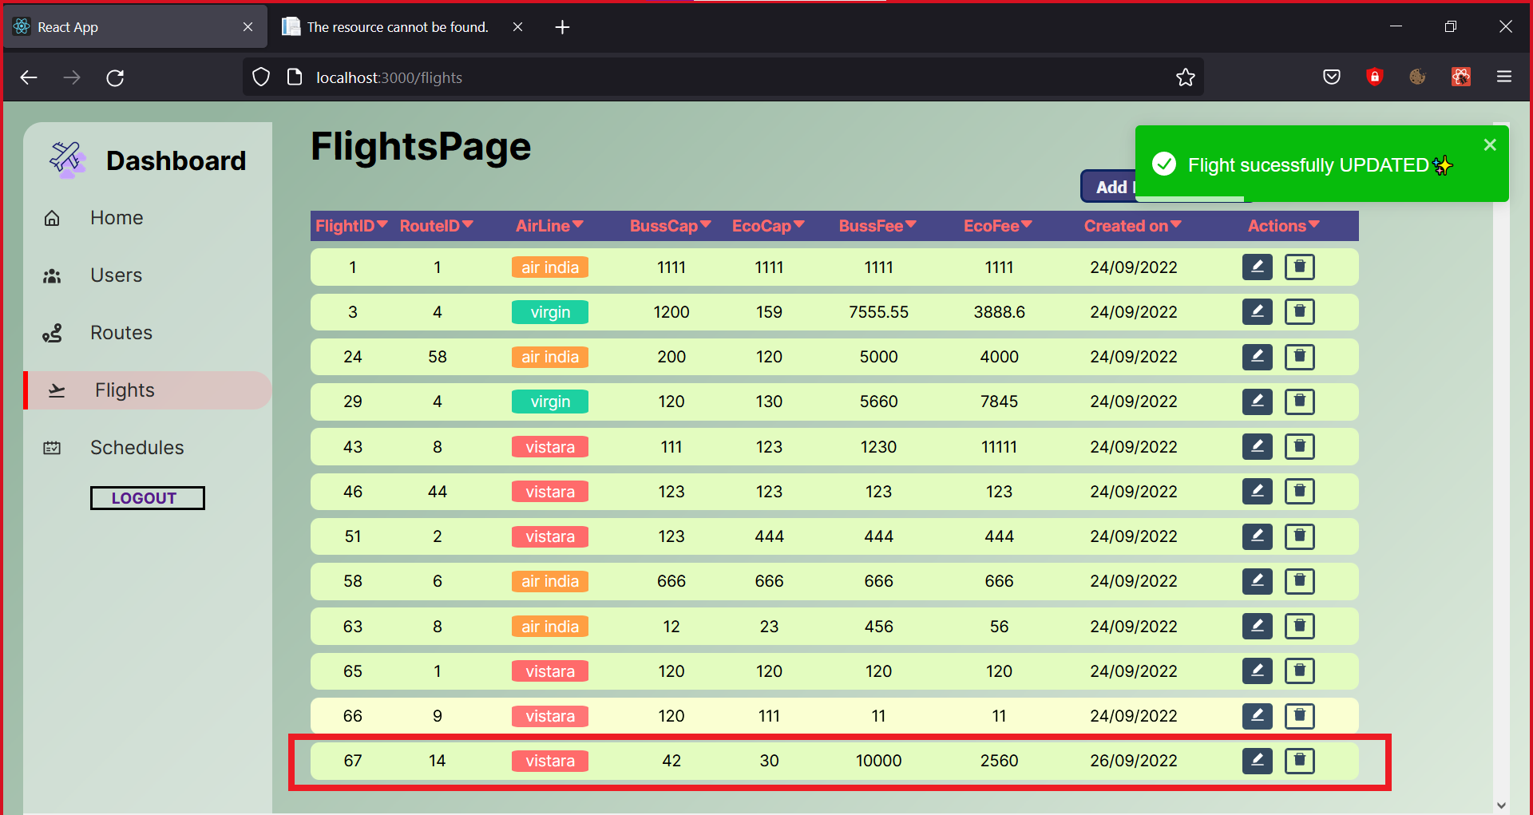
EDIT FLIGHTS

Slide 17
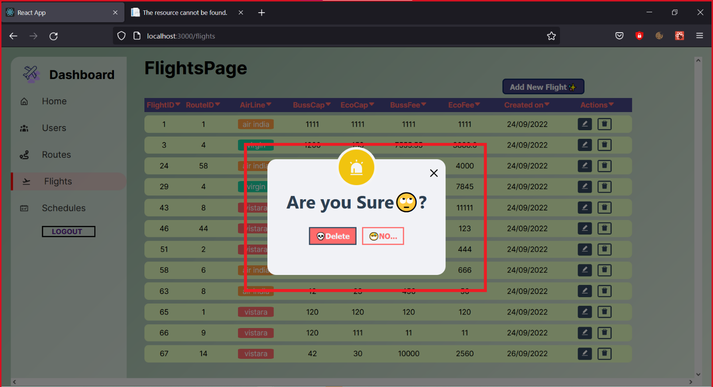
DELETE FLIGHTS

Slide 18
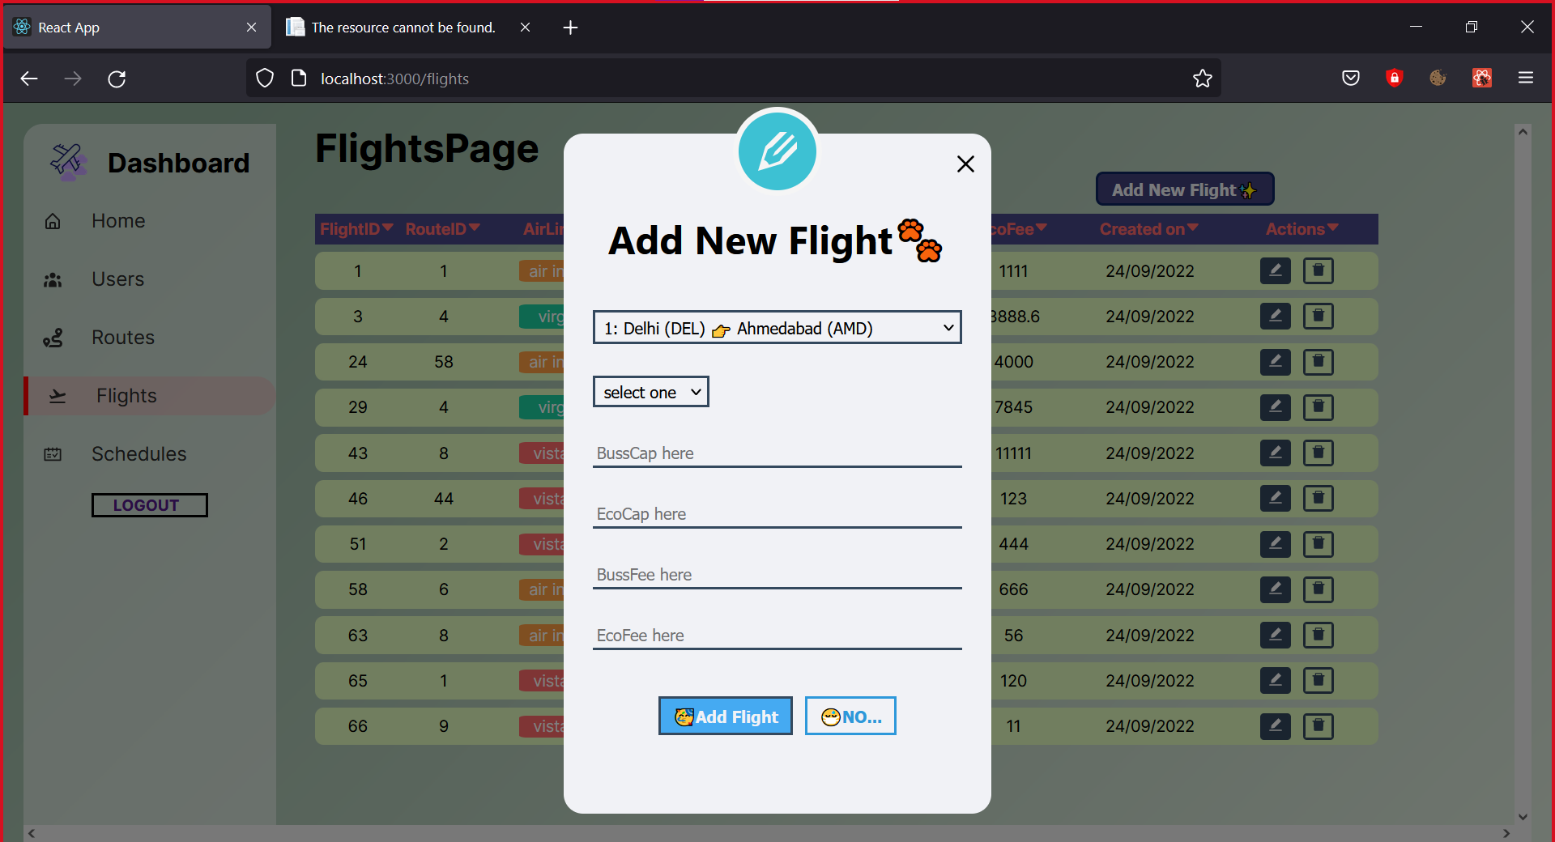
ADD NEW FLIGHTS

Slide 19
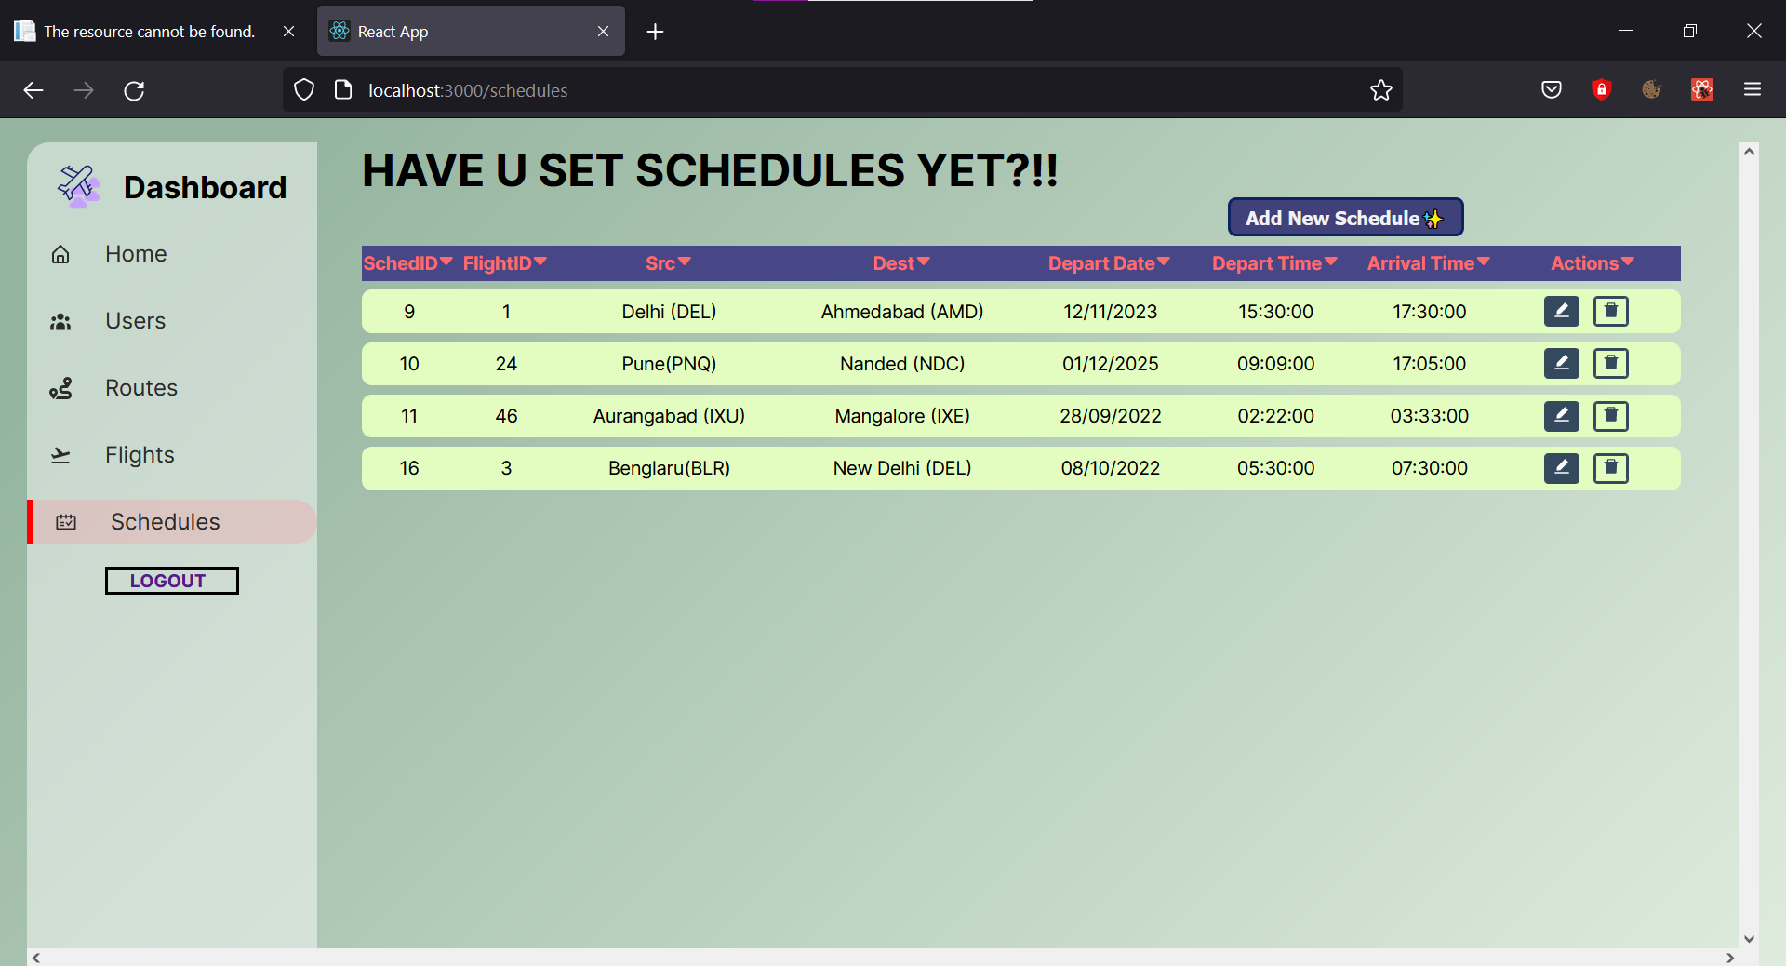
ADD NEW FLIGHTS

Slide 20
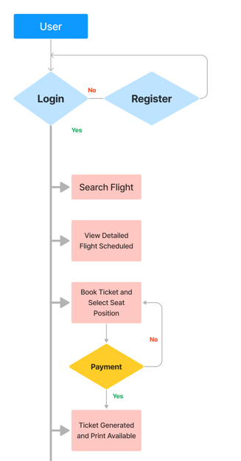
Use Case diagram for End User

Slide 21
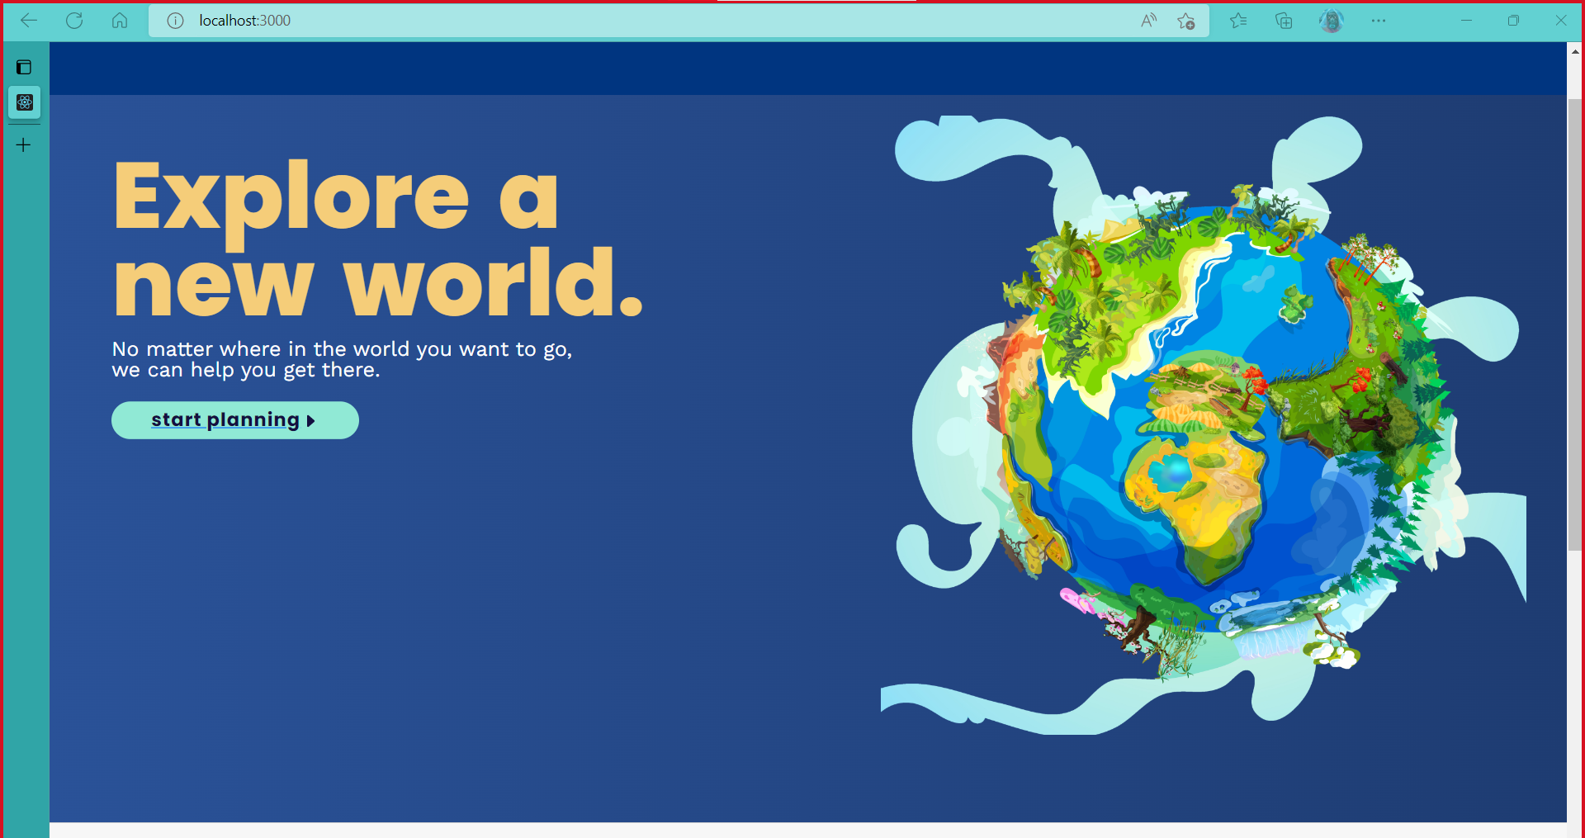
LANDING PAGE

Slide 22
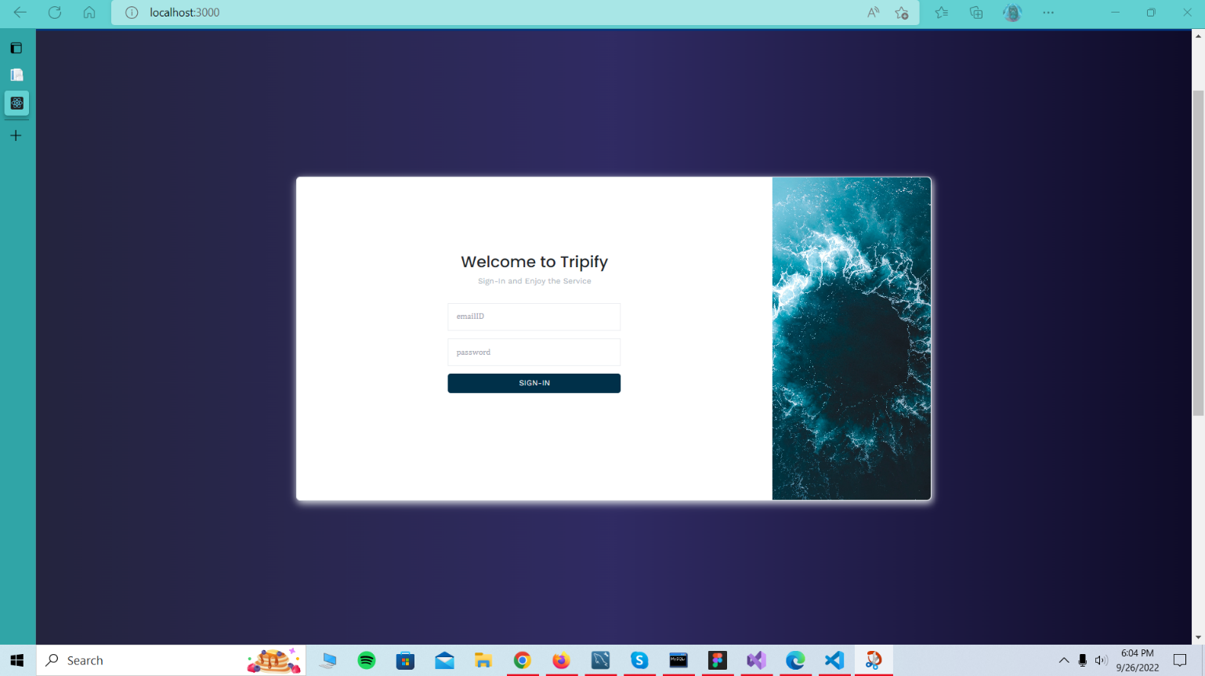
LOGIN/REGISTER PAGE

Slide 23
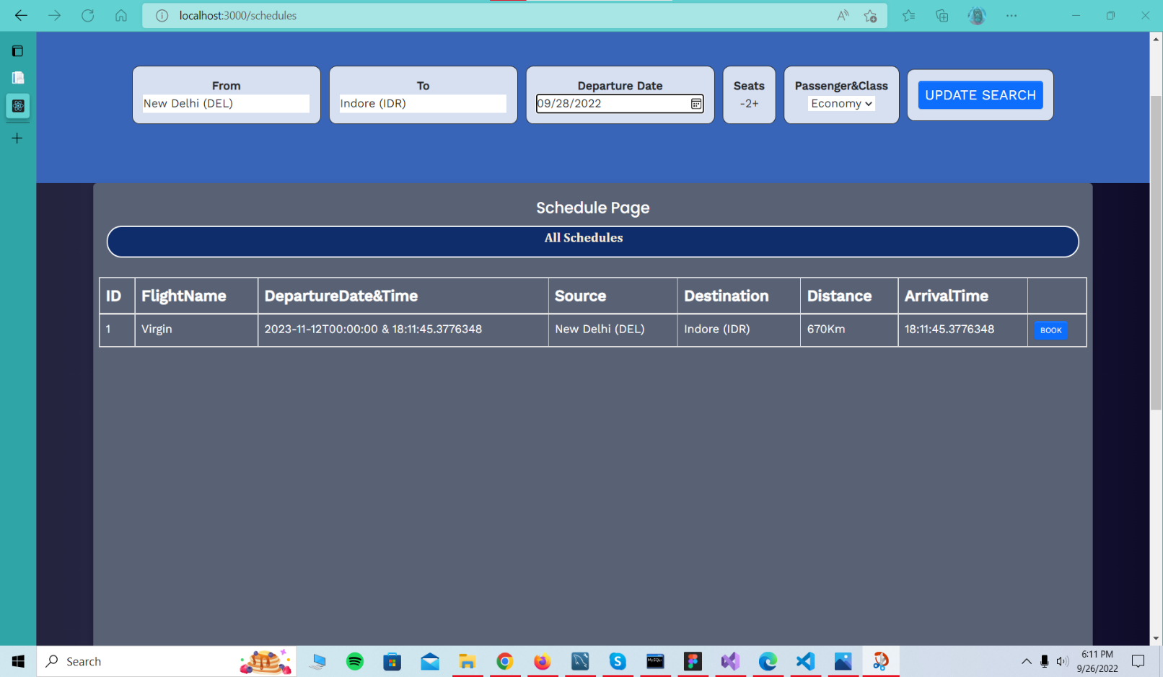
SCHEDULE PAGE

Slide 24
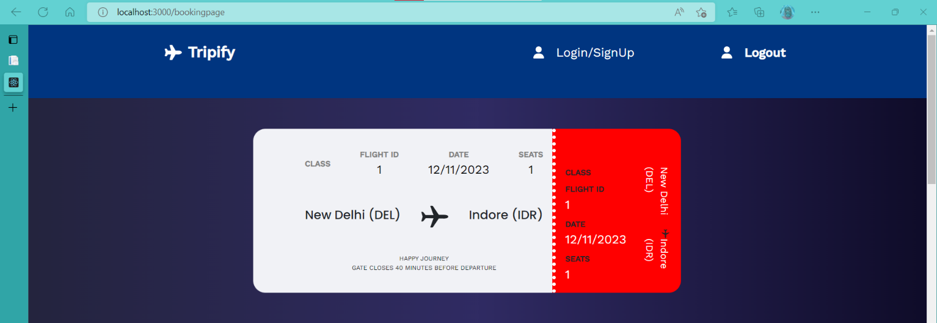
TICKET GENERATED

Slide 25
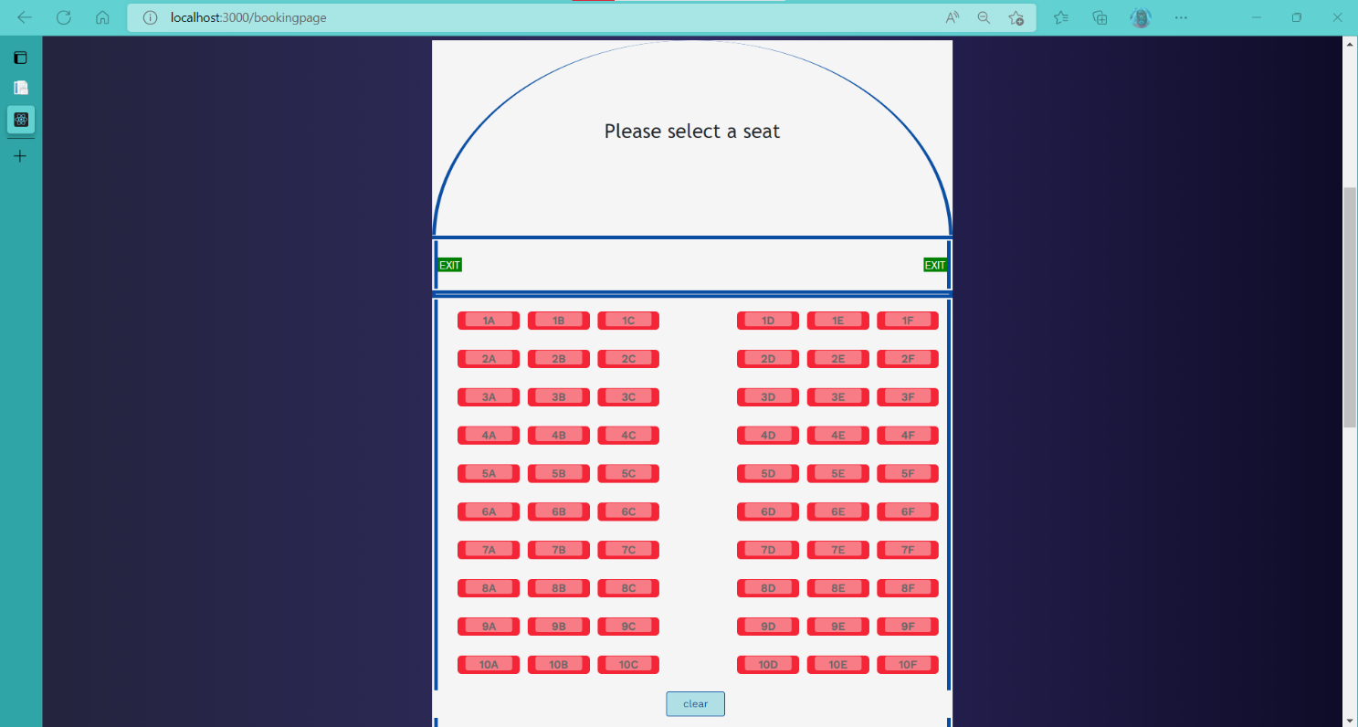
SEAT CHOICE

Slide 26
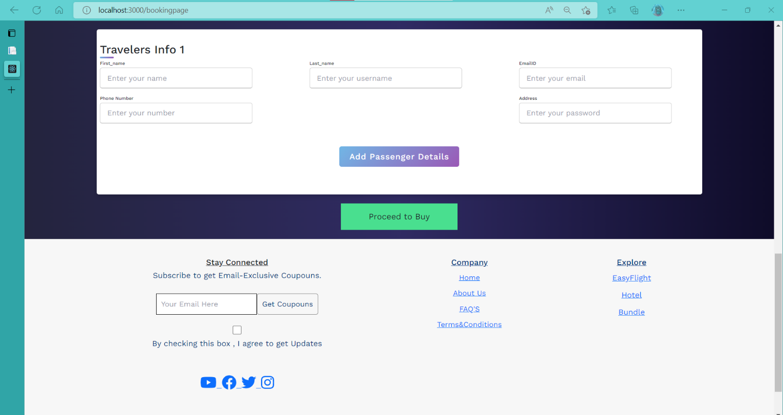
PASSANGERS DETAILS FORM

Slide 27
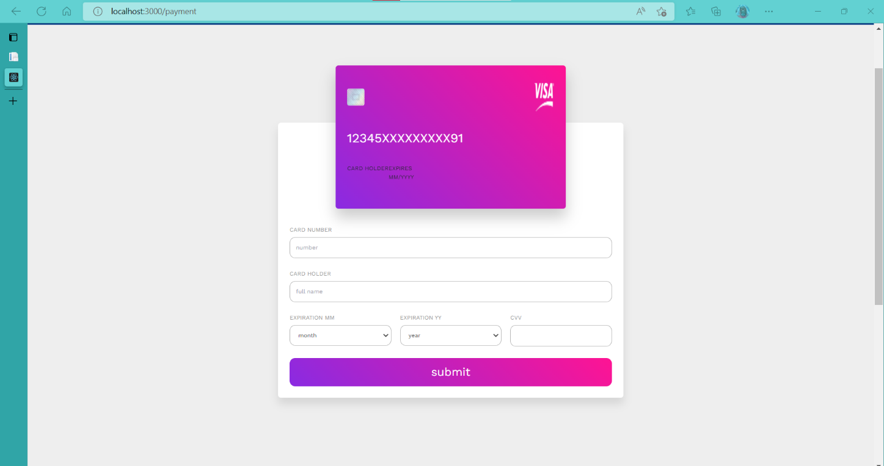
PAYMENT DETAILS FORM

Slide 28
THANK YOU

